Slide 1
Dodge Construction Forecast
Mid Year 2015
Cliff Brewis
Vice President Operations
Dodge Data & Analytics

Slide 2
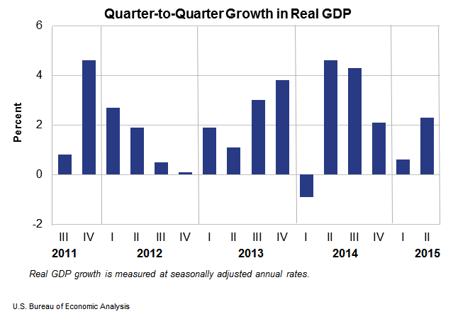
U.S. Macroeconomic Outlook
First quarter has often been soft.
GDP Pattern:
History Forecast
2010 2011 2012 2013 2014 2015
+2.5% +1.6% +2.3% +2.2% +2.2% +2.3%
Shape of Recovery:
Periods of moderate expansion have
been followed by deceleration.
Strength of Dollar complicates US Growth
Limited International Growth
Actions of the Fed

Slide 3
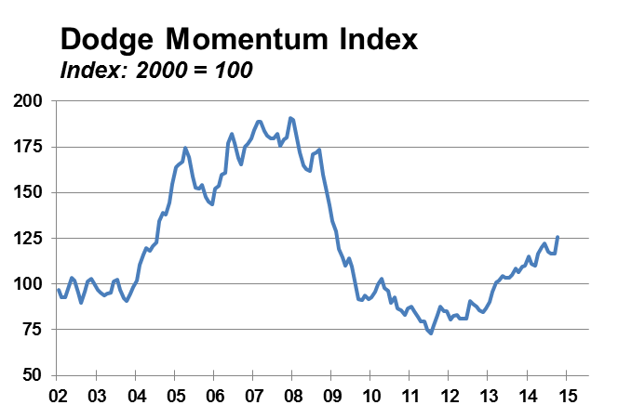
U.S. Construction Market Outlook –
The Dodge Momentum Index offers insight on what’s ahead.

Slide 4
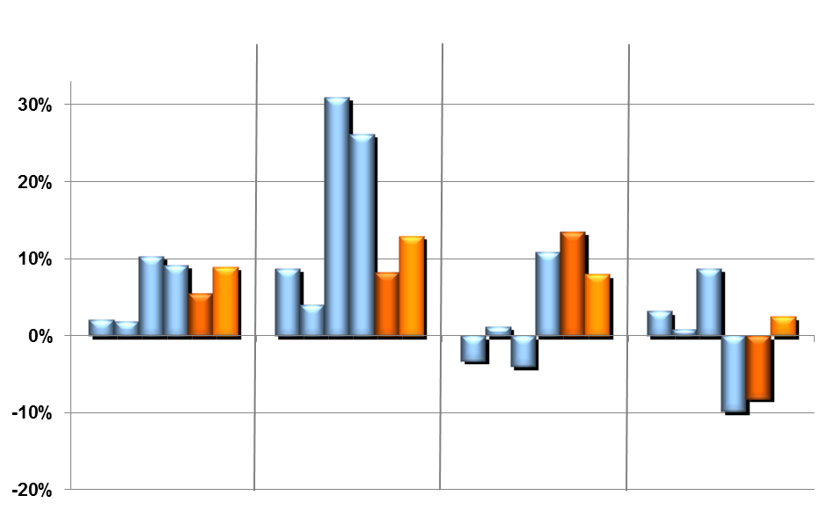

U.S. Construction Market Outlook –
Percent Change, 2010-2015, for Total Construction Starts and Major Sectors.
2014
Value
Residential
  Single Family
  Multifamily
Nonresidential
  Offices
  Hotels
  Warehouses
  Stores
  Education
  Healthcare
  Other Institutional
  Manufacturing
Nonbuilding
  Highways & Bridges
  Environmental Public Works
  Other Public Works
  Electric Utilities
.
History Forecast

Slide 5
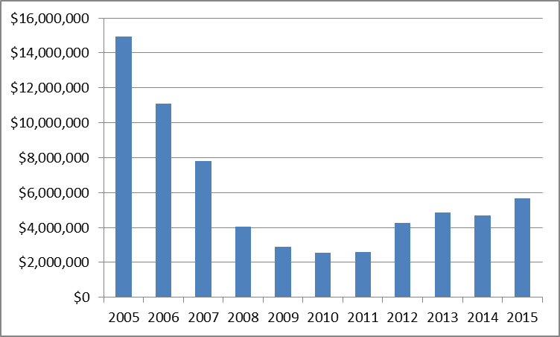
Arizona: Single Family Housing
Recovering but far below early 2000’s pace.

Slide 6
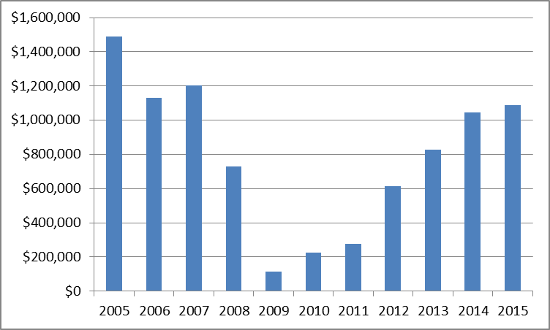
Arizona: Multifamily Housing
Very healthy sector but showing sings of leveling off.

Slide 7
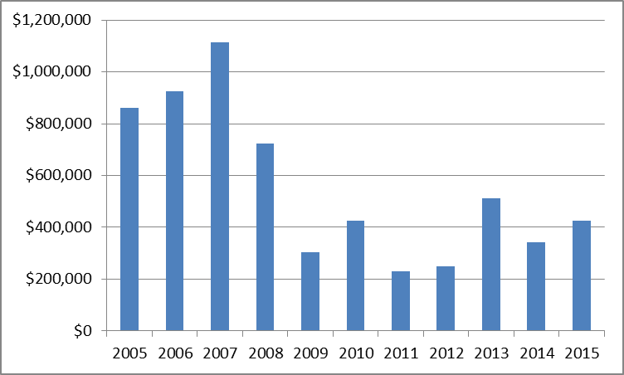
Arizona: Office Buildings
Conservative level of recovery.

Slide 8
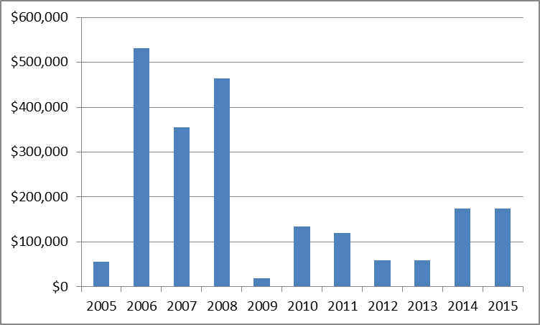
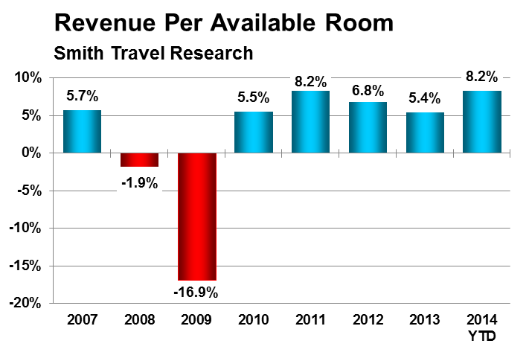
Arizona: Hotels
Conservative recovery.

Slide 9
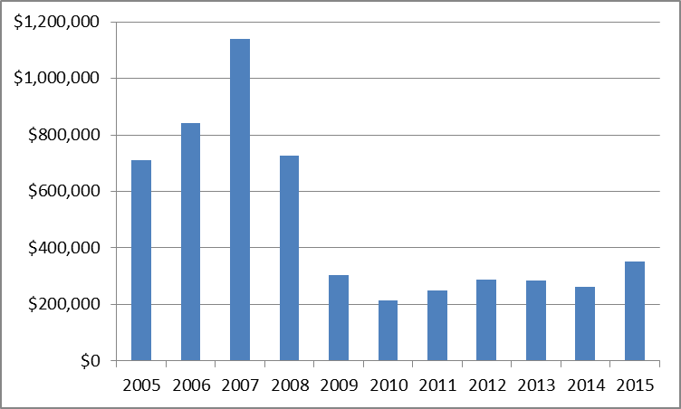
Arizona: Retail
Are you noticing a trend on the private side: conservative investment.

Slide 10
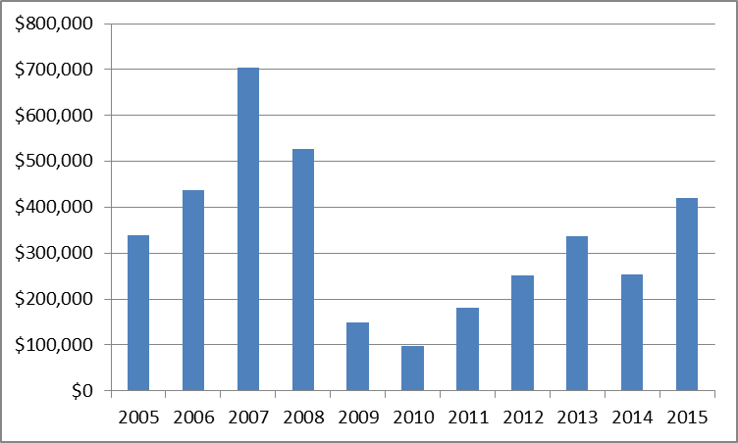
Arizona: Warehouses
Expanding more rapidly than retail.

Slide 11
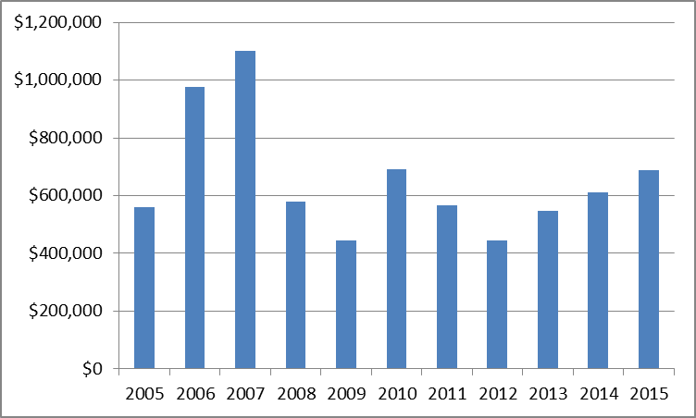
Arizona: Educational Buildings
The decline for the educational building category has ended, now turning up.

Slide 12
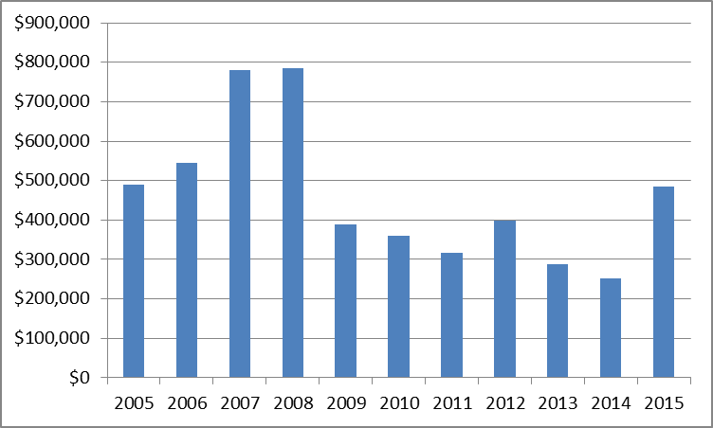
Arizona: Healthcare Buildings
Healthcare is surrounded by uncertainty.

Slide 13
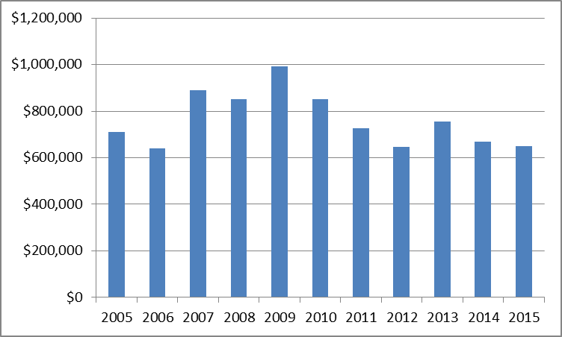
Arizona: Highways
Difficult to find sources of funding.

Slide 14
Arizona:

Slide 15
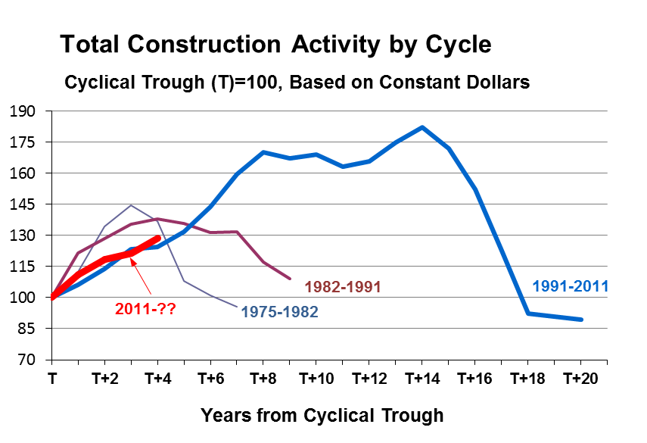
Points of Perspective

Slide 16
Questions
Cliff Brewis
Vice President Operations
Dodge Data and Analytics
Cliff.brewis@construction.com

